Slide 1

Exploring a larger dataset
Notes:
‹#›

Slide 2
Objectives
Exploring a dog and cat dataset
Understanding about Keras’ utilities for pre-processing image data
Learn how to plot training and validation accuracies to evaluate model performance
Exploring a larger dataset
‹#›

Slide 3
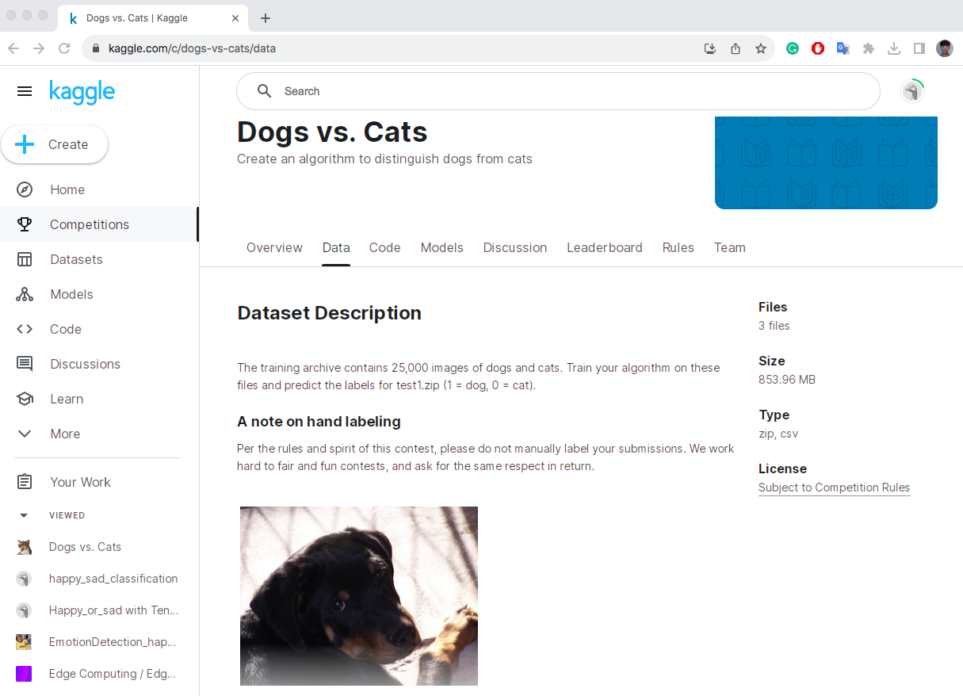
The cats vs dogs dataset
The training archive contains 25,000 images of dogs and cats.
https://www.kaggle.com/c/dogs-vs-cats/data
Exploring a larger dataset
‹#›
Notes:
‹#›

Slide 4
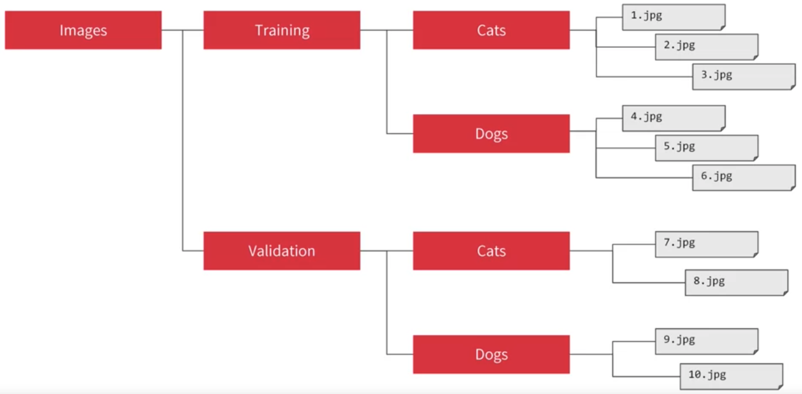
Training with cats vs dogs dataset
Image generators: training set and a validation set.
Image generators are often used in conjunction with the to perform on-the-fly data augmentation and loading of images during model training.
.
Exploring a larger dataset
‹#›
Notes:
‹#›

Slide 5
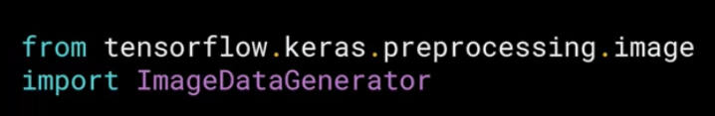
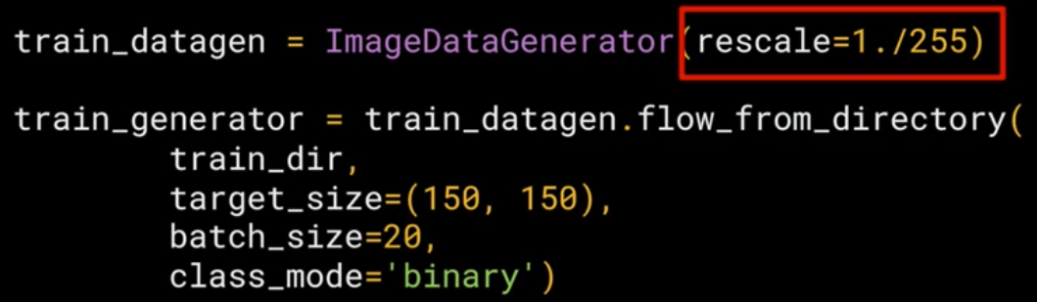
Training with cats vs dogs dataset
Image generators.
The ImageDataGenerator is configured with various augmentation parameters such as rotation, width and height shifts, shear, zoom, and horizontal flip.
The flow_from_directory method is used to create a generator that reads images from a directory. It automatically labels images based on subdirectory names
Exploring a larger dataset
‹#›
Notes:
‹#›

Slide 6
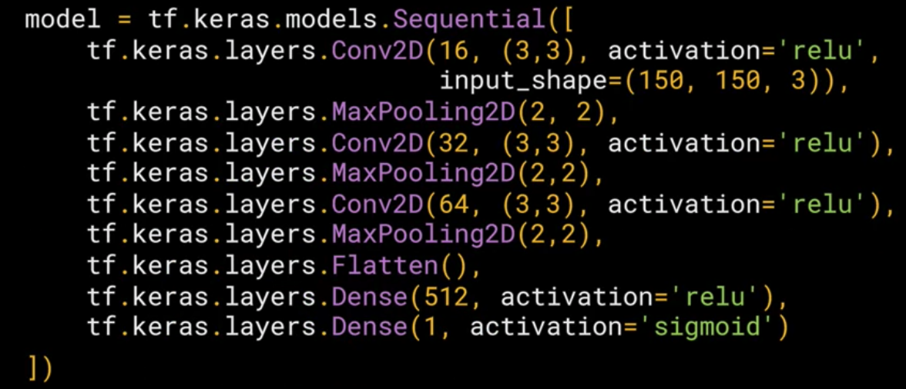
Training with cats vs dogs dataset
Create ConvNets
Exploring a larger dataset
‹#›
Notes:
‹#›

Slide 7
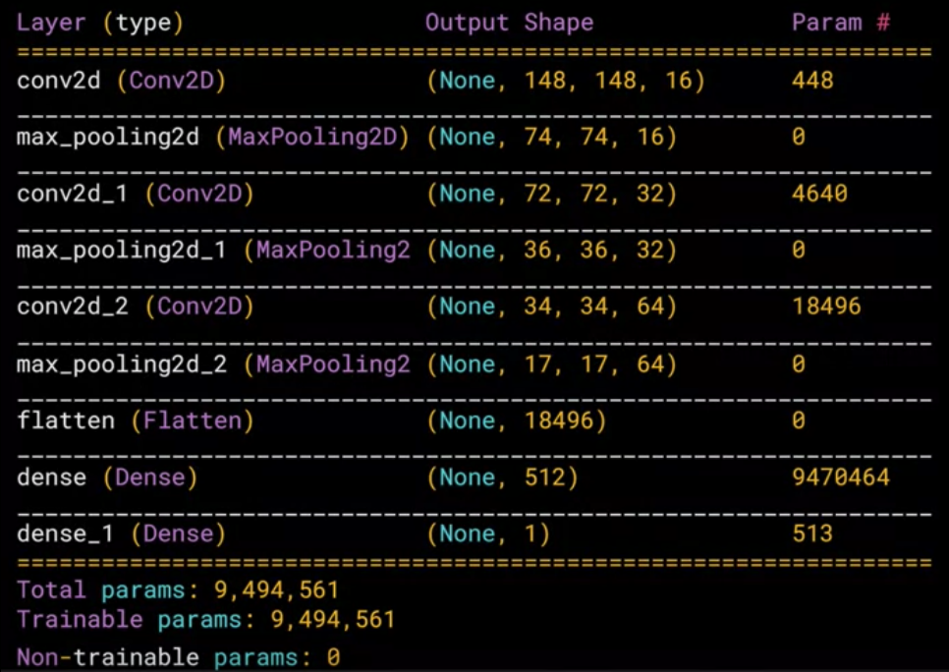
Training with cats vs dogs dataset
Summary of the layers: start with 150 by 150→ convolution reduces that to 148 by 148
Exploring a larger dataset
‹#›
Notes:
‹#›

Slide 8
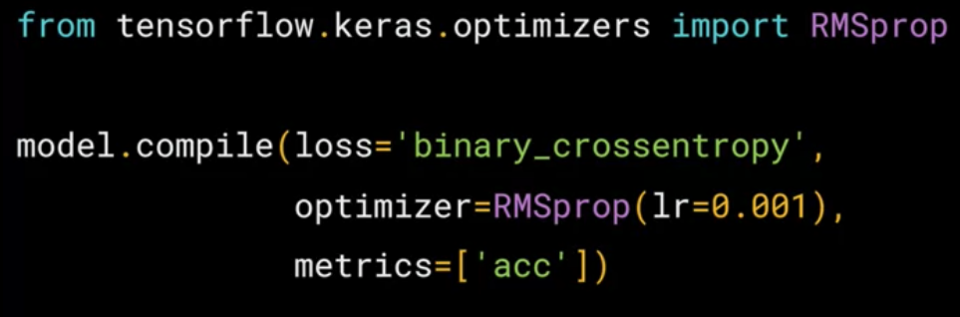
Training with cats vs dogs dataset
Compile
Exploring a larger dataset
‹#›
Notes:
‹#›

Slide 9
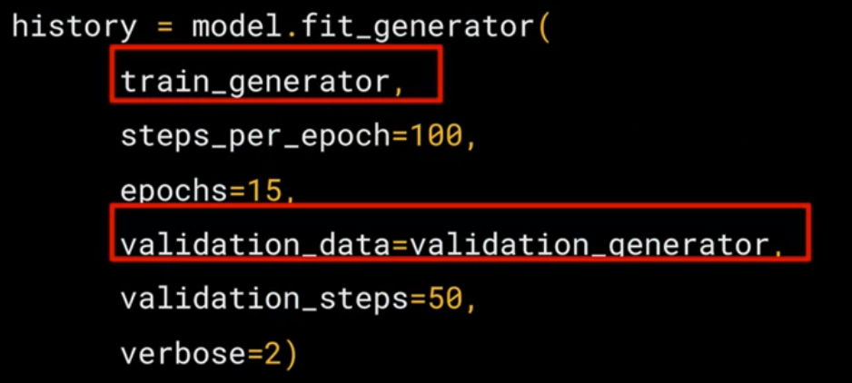
Training with cats vs dogs dataset
Training
Exploring a larger dataset
‹#›
Notes:
‹#›

Slide 10
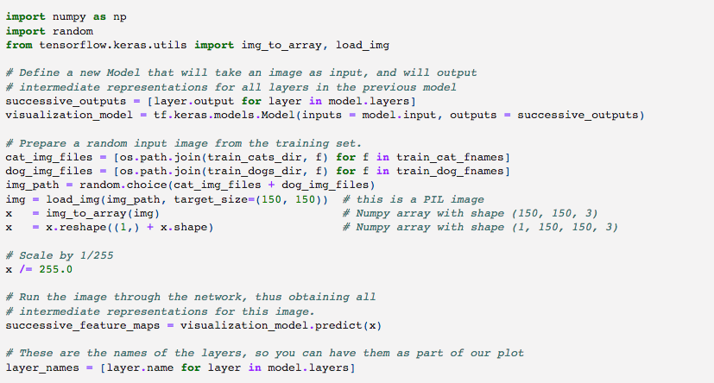
Visualizing the effect of the convolutions
Run the code below and give your opinions: how do you understand convolutions
Exploring a larger dataset
‹#›
Notes:
‹#›

Slide 11
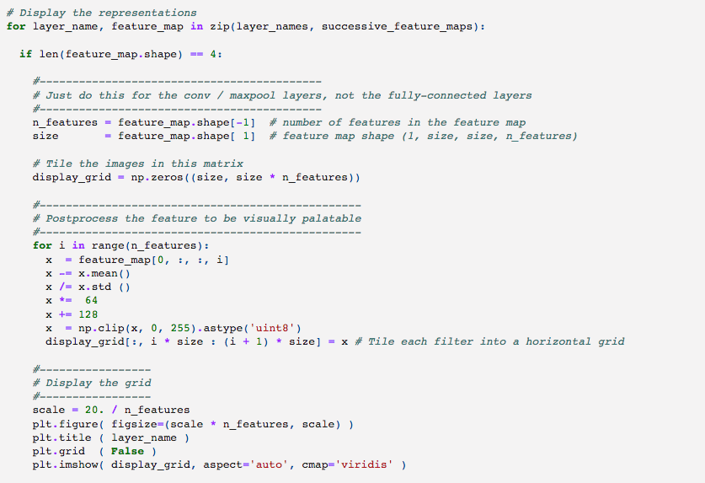
Visualizing the effect of the convolutions
Exploring a larger dataset
‹#›
Notes:
‹#›

Slide 12
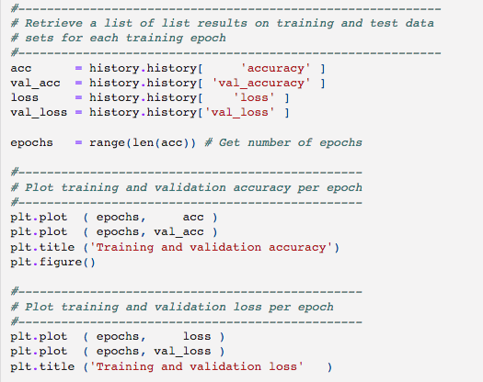
Looking at accuracy and loss
Plot the training/validation accuracy and loss as collected during training and answer the question: what happened to this model?
Exploring a larger dataset
‹#›
Notes:
‹#›

Slide 13
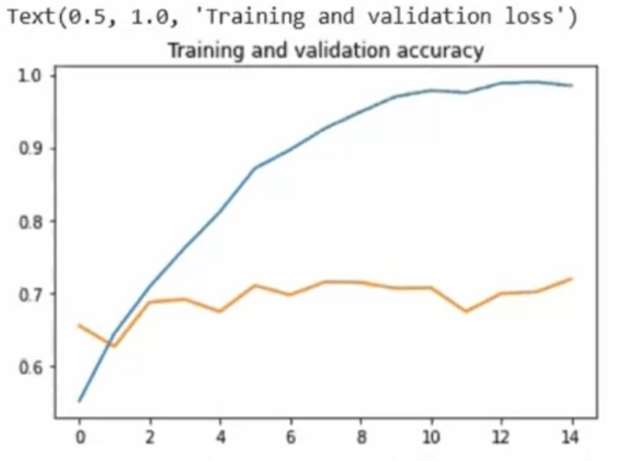
Looking at accuracy and loss
Overfiting ?
Exploring a larger dataset
‹#›
Notes:
‹#›

Slide 14
Summary
Exploring a dog and cat dataset
Understanding about Keras’ utilities for pre-processing image data
Learn how to plot training and validation accuracies to evaluate model performance
Exploring a larger dataset
‹#›

Slide 15
Q & A
Exploring a larger dataset
‹#›

